Slide 1

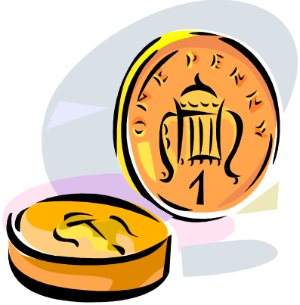
Daily CSI
Penny Challenge
How observant are you?
8th Grade Forensic Science
T. Trimpe 2006 http://sciencespot.net/

Slide 2
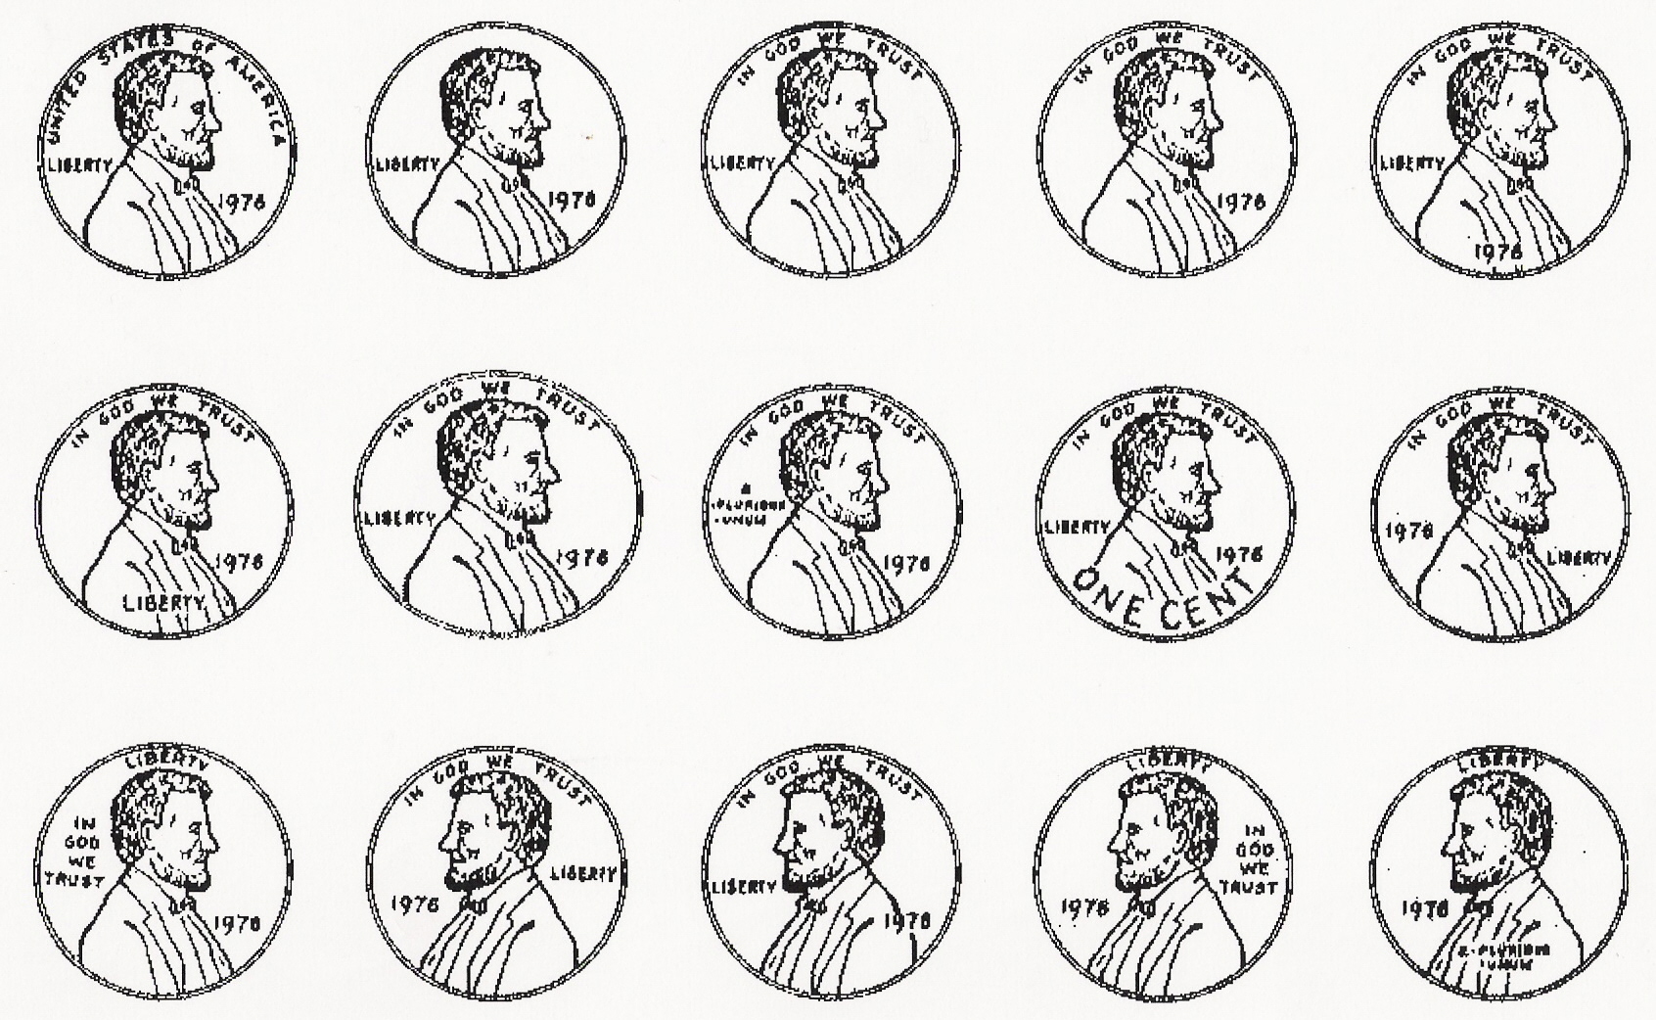
Which is the correct penny?
NOTE: You cannot look at a real penny!
1
2
3
4
5
6
7
8
9
10
11
12
13
14
15

Slide 3
Answer
1
2
3
4
5
6
7
8
9
10
11
12
13
14
15

